Slide 1
U.S. Small Business
Administration

Slide 2
Agenda
Non-Monetary Assistance
from the US SBA and our Partners
Financial Assistance from the US SBA
for Small Businesses and Non-Profits
Additional Resources
These Slides are available to download at: www.sba.gov/tx/houston

Slide 3
Non-Monetary Assistance

Slide 4
Important Non-Monetary Assistance from SBA
SBA has three local Resource Partners
Texas Gulf Coast Small Business Development Centers (SBDC)
SCORE Mentors
The WBEA Women’s Business Center (WBC)
A range of help during the downturn, to include:
Cash flow management / short term financial management
Messaging / Social Media to stay engaged with customers
Import/Export
Supply Chain
Strategic Planning and Financial Tune-Up; prepare to prosper after the disaster
Planning for further disasters / Risk management / Insurance counseling

Slide 5
Contact Information
Small Business Development Center 713-752-8444 www.sbdc.uh.edu | Houston SCORE 713-487-6565 www.houston.score.org
Women’s Business Center 713-681-9232 www.wbea-texas.org/womens-business-center | U.S. Small Business Administration 713-773-6500 SIGN-UP FOR EMAIL UPDATES: www.sba.gov/tx/houston FOLLOW US ON TWITTER: @SBA_Houston

Slide 6
Financial Assistance
From the US SBA

Slide 7
The CARES Act
Signed into law Friday, March 27, 2020
SBA policy regarding the CARES Act issued late April 2
You should read the Act
We can not offer legal interpretation of the Act
We can not comment on portions of the Act unrelated to US SBA
The complete CARES Act is located here:
https://www.congress.gov/bill/116th-congress/house-bill/748/text

Slide 8
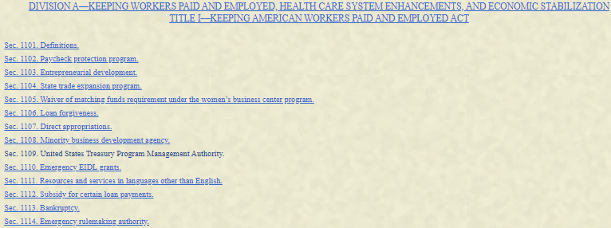

The CARES Act

Slide 9
SBA Debt Relief
7(a), 504, & Microloans
The SBA will automatically pay the principal, interest, and fees of current 7(a), 504, and microloans in regular servicing status for a period of six months.
Existing Disaster Loans
SBA will defer existing loan payments through December 31, 2020 automatically.
Borrowers of home and business disaster loans do not have to contact SBA to request deferment.
If Lender receives a payment from a Borrower after March 27, 2020, they must inform Borrower it has the option of: Lender either returning the payment or applying the payment to further reduce the balance.

Slide 10
Passage of the
Coronavirus Aid, Relief, and Economic Security (CARES) Act
Gives Businesses TWO Loan Choices
Affected, Eligible Business?
1
2
Paycheck Protection Program (PPP)
Economic Injury Disaster Loan (EIDL)
Loan is from existing SBA Lender
Loan is directly from the federal government (SBA)

Slide 11
Eligibility Update- Faith Based Organizations
Faith-based organizations, including houses of worship, are now eligible to receive SBA loans under the PPP and EIDL programs.
Churches and related institutions qualify for PPP and EIDL loans as long as they meet the requirements of Section 501(c)(3)
Organizations must be small. If in doubt check SBA’s size standards tables https://www.sba.gov/document/support--table-size-standards

Slide 12
Eligibility Update- Farm/Ranches
Agricultural producers, farmers, and ranchers with 500 or fewer employees whose principal place of residence is in the United States are eligible.
Farms are eligible if: (i) the farm has 500 or less employees, OR (ii) it fit within the revenue-based sized standard, which is an average annual receipts of $1M.
Additionally, farms can qualify for PPP if it meets SBA’s “alternative size standard.” The “alternative size standard” is currently: (1) a maximum net worth of the business not more than $15 million, AND (2) the average net income Federal income taxes of the business for the two full fiscal years before the date of the application be not more than $5 million.

Slide 13
EIDL Loans

Slide 14
Economic Injury Disaster Loans (EIDL)
Loans up to $2 million; no payments for 12 months
Small businesses, Small Ag cooperatives, and private non-profits are eligible
May be used for fixed debts, payroll, accounts payable and other bills affected by the disaster
May be approved solely on the applicant credit score.
Long-term repayments up to 30 years
3.75% interest rate for small businesses; 2.75% for private non-profits.

Slide 15
Additional EIDL Details
No cost to apply; No obligation to take the loan (if offered)
Amount is determined by SBA from your information
Existing SBA Disaster or Business loans do not make you ineligible
Personal guarantee requirements:
Collateral:
If over $25,000 EIDLs require collateral
SBA will not decline for lack of collateral, but requires the pledge of what is available
Does not require primary residence in Texas
None if loan is under $200,000
If over $200,000 then guarantee from all 20% or greater owners

Slide 16
CARES Act - EIDL Grant
Until Dec 31, 2020 affected small businesses may request
Up to $10,000
Eligibility determined by self-certification
Payment should occur within 3 days
Repayment is not required even if subsequently denied a loan
Advance may be used for any purpose described in section 7(b)(2) of the Small Business Act (15 U.S.C. 636(b)(2)), including:
  paid employee sick leave if unable to work due to the direct effect of the COVID–19
  payroll to retain employees
  increased costs to obtain materials unavailable due to interrupted supply chains
  rent or mortgage payments
  obligations that cannot be met due to revenue losses
NOTE: An applicant may receive an EIDL Loan and a PPP loan as long as the costs being paid with each are different (no "double-dipping").

Slide 17
How to Apply for EIDL
For the COVID-19 disaster everything is online
  Works on iPhone with Safari / Chrome on Android
  If PC; works best with Internet Explorer or Microsoft Edge
The website for applying for EIDL is www.sba.gov/disaster
You may also contact the SBA disaster customer service center:
  1-800-659-2955
  e-mail disastercustomerservice@sba.gov
  TTY: 1-800-877-8339

Slide 18
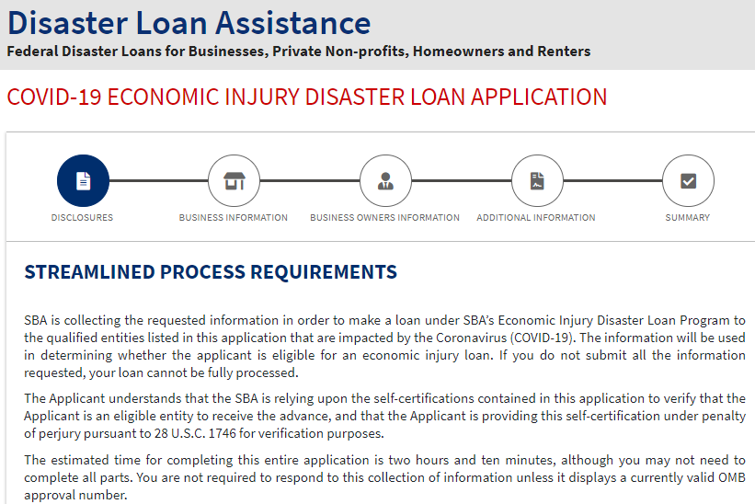

Slide 19
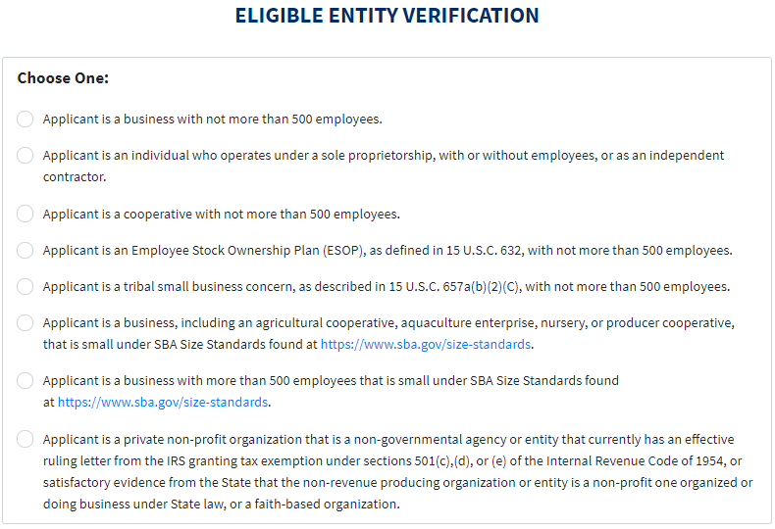

Slide 20
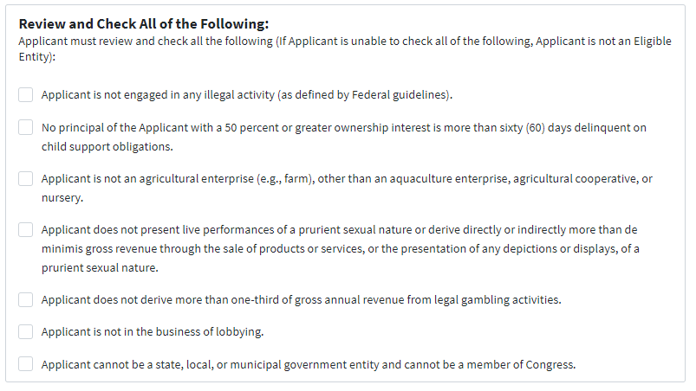

Slide 21
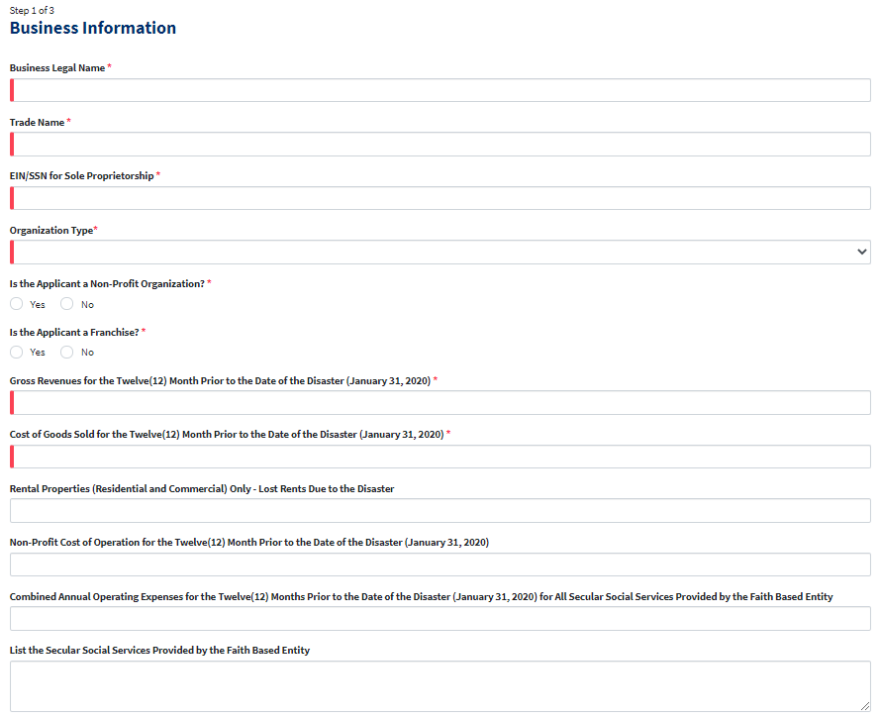
Business Information (1 of 2)

Slide 22
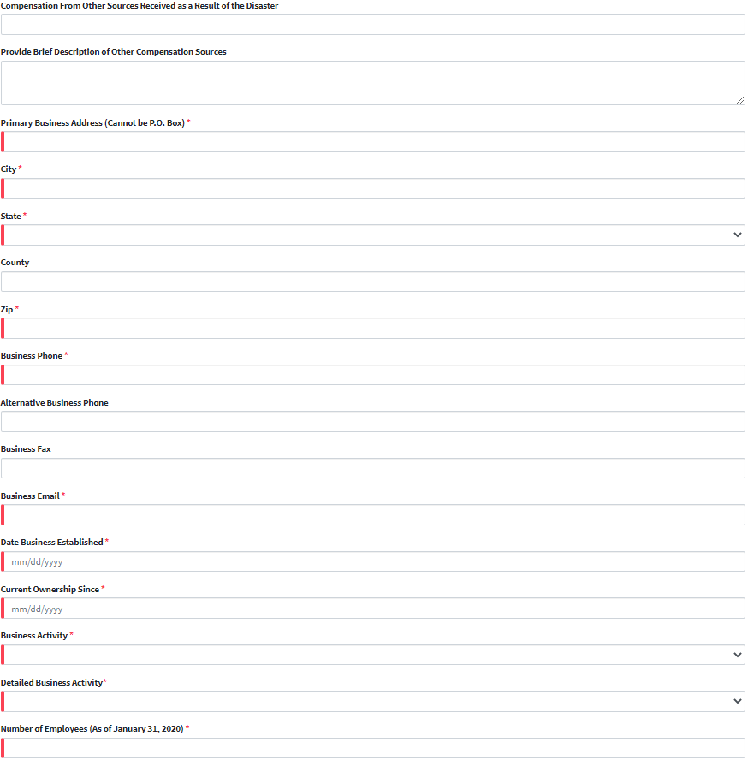
Business Information (2 of 2)

Slide 23
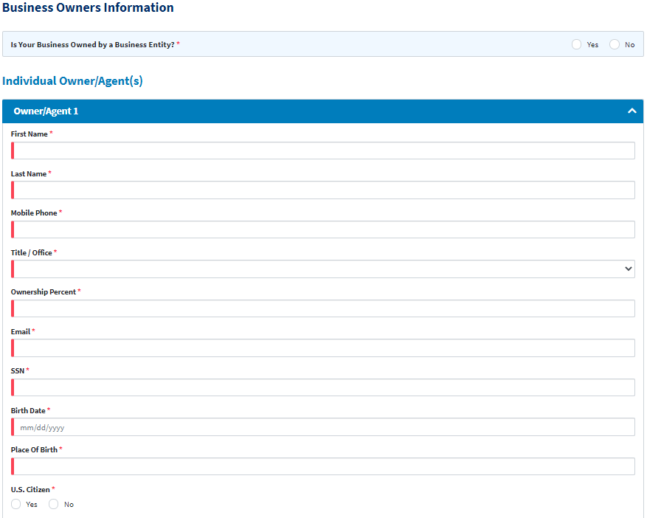
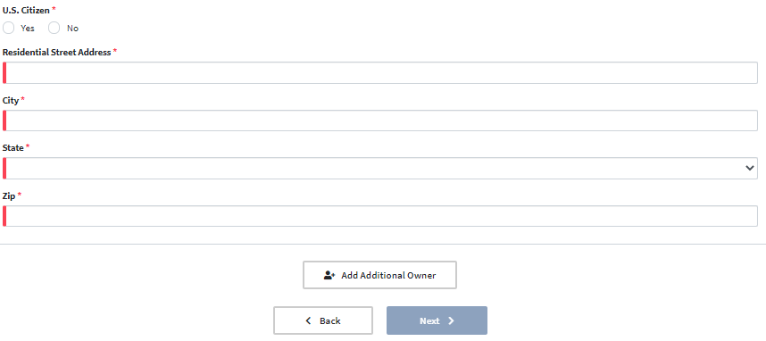
Owner Information

Slide 24
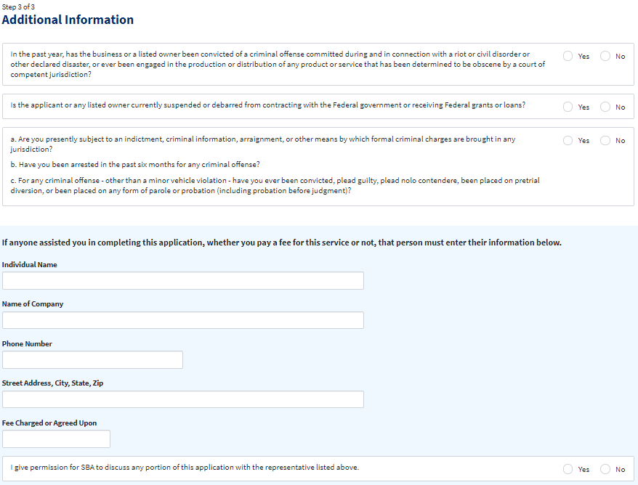
Additional Information (1 of 2)

Slide 25
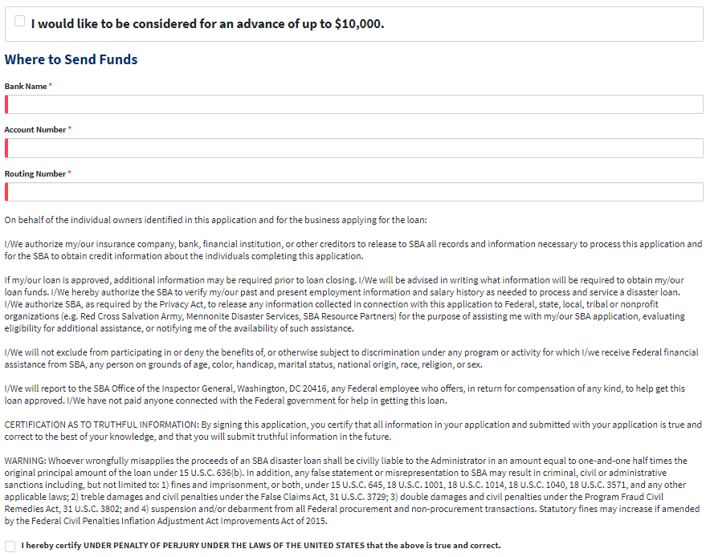
Additional Information (2 of 2)

Slide 26
After Applying
Loan Processing Decision
Information verified; credit checked; you may be asked for more info
EIDL amount is determined
A loan officer contacts you; makes recommendations
Decision normally takes up to 4 weeks
Loan Closes and Funds Disbursed
Sign and Submit Loan Documents
Initial disbursement of $25K (this doesn’t include the up to $10K Advance) within 5 days
Case Manager assigned that will help you with the rest

Slide 27
Important Final Notes About EIDL Applications
If more funds are needed you can submit supporting documents and request an increase
If less funds are needed you can request a reduction
If denied:
  you get six months to provide a written reconsideration request with new / supplemental information
  If denied a second time, you get an additional 30 days to appeal
Please complete and submit everything required

Slide 28
Non-SBA Additional Info

Slide 29
Additional Info / Resources
See your existing bank – they may have non-SBA programs to help
We have heard about:
  PeopleFund and LiftFund Programs
Texas Restaurant Association Grant Program
Galveston EDA Short-term Loan Program: https://bit.ly/2UrL001
Non-Profit Organization Assistance
More coming…

Slide 30
Contact Information
Small Business Development Center 713-752-8444 www.sbdc.uh.edu | Houston SCORE 713-487-6565 www.houston.score.org
Women’s Business Center 713-681-9232 www.wbea-texas.org/womens-business-center | U.S. Small Business Administration 713-773-6500 SIGN-UP FOR EMAIL UPDATES: www.sba.gov/tx/houston FOLLOW US ON TWITTER: @SBA_Houston

Slide 31
Small Business Scam & Fraud Scheme Advisory
The presence of an SBA logo on a webpage or correspondence does not guaranty the information is from the SBA
If someone contacts you promising to get approval of an SBA loan, but requires any payment up front, suspect fraud
After you apply:
  Verify all correspondence you receive; that the application number is the same as your actual application number
  Any email communication from SBA will end with gov
SBA limits the fees a broker can charge a borrower
SBDC/SCORE/WBC do not charge for their services
Report any suspected fraud to OIG’s Hotline at 800-767-0385 or online at, https://bit.ly/2UxdAhL

Slide 32
Most Common Questions

Slide 33
Common Questions (1/2)
Visit www.sba.gov/tx/houston, under Coronavirus resources:
  For a copy of this slide deck & the Houston District SBA lender list
Can I check status of my application online?
  YES, but not currently on the website. To be updated soon.
  Until then email or phone disaster customer service 1-800-659-2955 (24/7).
  The Houston District office is unable to check status.
Are EIDL loans forgiven?
  NO, but the Advance is a grant (is forgiven)
How is the up to $10K EIDL Relief Grant calculated?
  Determined by the number of pre-disaster (i.e., as of January 31, 2020) employees. The Advance will provide $1,000 per employee up to a maximum of $10,000.

Slide 34
Common Questions (2/2)
Can I apply for both EIDL and PPP?
  YES; however, you cannot duplicate costs.
Which loan should I apply for EIDL or PPP?
  Each business is different. Our network of local, free resources can help.
I have already submitted my EIDL application can I submit for the PPP loan?
  YES, just don’t duplicate costs included in the EIDL.
  If payroll was on the EIDL, you must refinance the EIDL into the PPP
I have already submitted my EIDL application but didn’t get the Advance?
  Submit the new application even if you previously submitted an EIDL application. Applying for the Advance will not impact the status or slow your existing application.

Slide 35
For questions about your specific situation
For the EIDL Loan; SBA Disaster Customer Service:
  1-800-659-2955 -- TTY: 1-800-877-8339
  e-mail disastercustomerservice@sba.gov
For the PPP Loan:
  Contact the SBA lender of your choice
  Lender list at www.sba.gov/tx/Houston under Coronavirus Resources
One of our Resource Partners for general guidance:
  Texas Gulf Coast SBDC 713-752-8444 www.sbdc.uh.edu
  Houston SCORE 713-487-6565 www.houston.score.org
  Women’s Business Center 713-681-9232 www.wbea-texas.org/womens-business-center

